Slide 1



FPT Software
ANDROID TRAINING
LESSON 1
Version 0.1

Slide 2
Agenda
References
Tools
Android SDK
Creating a Project
Project Components
  XML
  R Class
  Layouts
  Strings
  Manifest File

Slide 3
References
This lesson is a brief overview of some major concepts
Developer’s Guide
  http://developer.android.com/guide/index.html
API Reference
  http://developer.android.com/reference/packages.html

Slide 4
Tools
Phone
Eclipse ( http://www.eclipse.org/downloads/ )
  Android Plugin (ADT)
Android SDK ( http://developer.android.com/sdk/index.html )
  Install everything except Additional SDK Platforms, unless you want to

Slide 5
Android SDK
Once installed open the SDK Manager
Install the desired packages
Create an Android Virtual Device (AVD)

Slide 6
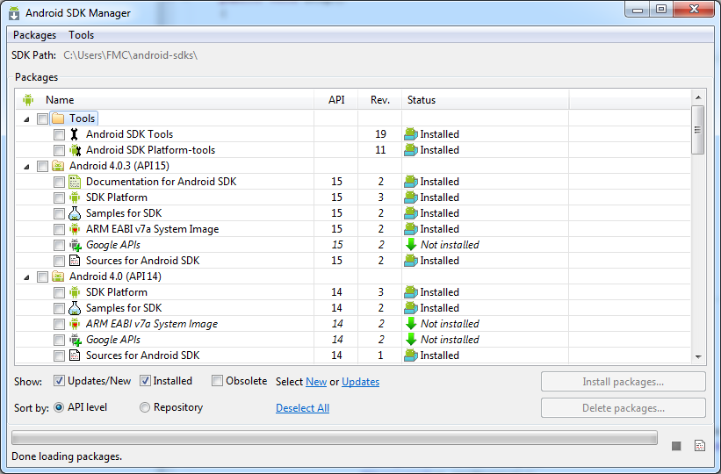
SDK Manager

Slide 7
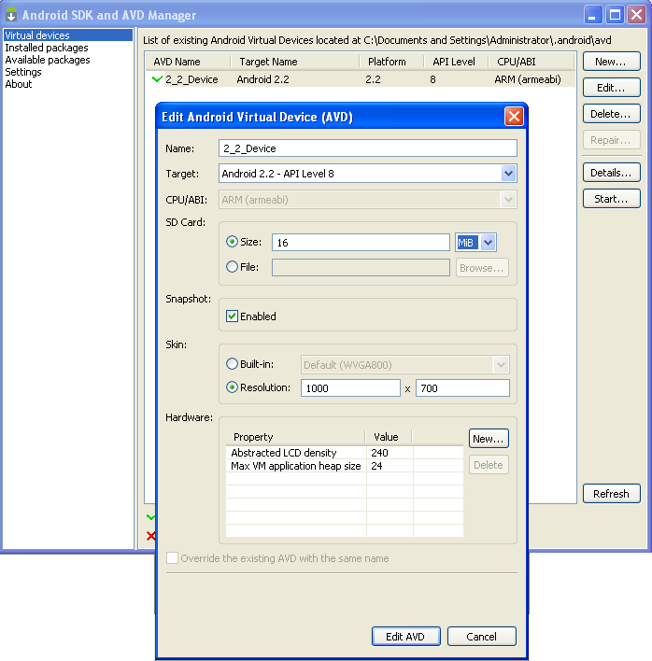
AVD

Slide 8
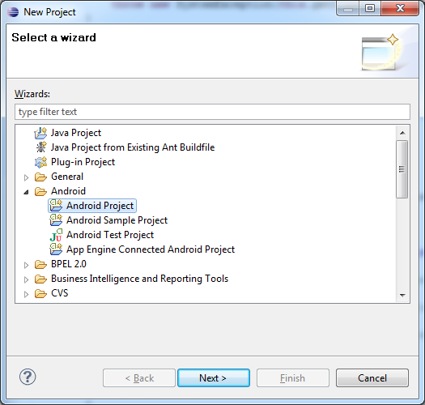
Creating a Project
In Eclipse, select “File -> New -> Project….”, “Android Project”, and input your application detail. Eclipse will create all the necessary Android project files and configuration.

Slide 9
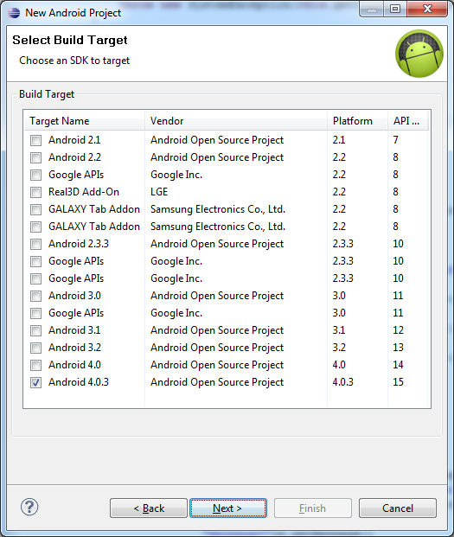
Creating a Project

Slide 10
Project Components
src – your source code
gen – auto-generated code (usually just R.java)
Included libraries
Resources
  Drawables (like .png images)
  Layouts
  Values (like strings)
Manifest file

Slide 11
XML
Used to define some of the resources
  Layouts (UI)
  Strings
Manifest file
Shouldn’t usually have to edit it directly, Eclipse can do that for you
Preferred way of creating UIs
  Separates the description of the layout from any actual code that controls it
  Can easily take a UI from one platform to another

Slide 12
R Class
Auto-generated: you shouldn’t edit it
Contains IDs of the project resources
Use findViewById and Resources object to get access to the resources
  Ex. Button b = (Button)findViewById(R.id.button1)
  Ex. getResources().getString(R.string.hello));

Slide 13
Layouts (1)
Eclipse has a great UI creator
  Generates the XML for you
Composed of View objects
Can be specified for portrait and landscape mode
  Use same file name, so can make completely different UIs for the orientations without modifying any code

Slide 14
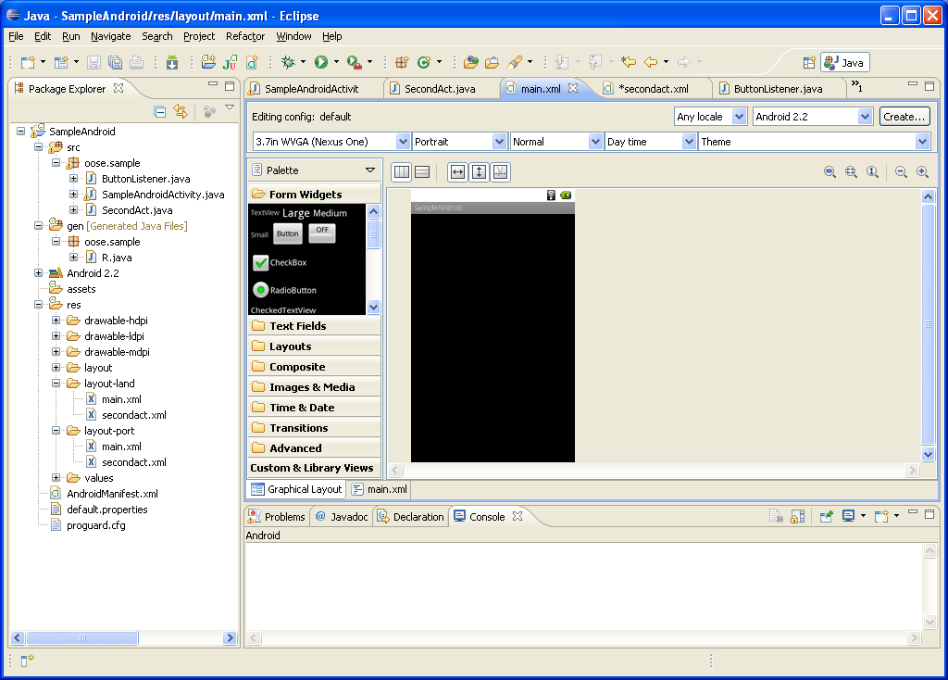
Layouts (2)

Slide 15
Layouts (3)
Click ‘Create’ to make layout modifications
When in portrait mode can select ‘Portrait’ to make a res sub folder for portrait layouts
  Likewise for Landscape layouts while in landscape mode
  Will create folders titled ‘layout-port’ and ‘layout-land’
Note: these ‘port’ and ‘land’ folders are examples of ‘alternate layouts’, see here for more info
  http://developer.android.com/guide/topics/resources/providing-resources.html
Avoid errors by making sure components have the same id in both orientations, and that you’ve tested each orientation thoroughly

Slide 16
Strings
In res/values
  strings.xml
Application wide available strings
UI components made in the UI editor should have text defined in strings.xml
Strings are just one kind of ‘Value’ there are many others

Slide 17
Manifest File
The application must declare all its components in this file, which must be at the root of the application project directory.
The manifest does a number of things in addition to declaring the application's components, such as:
  Identify any user permissions the application requires, such as Internet access or read-access to the user's contacts.
  Declare the minimum API Level required by the application, based on which APIs the application uses.
  Declare hardware and software features used or required by the application, such as a camera, bluetooth services, or a multitouch screen.
  API libraries the application needs to be linked against (other than the Android framework APIs), such as the Google Maps library.
  And more

Slide 18
Manifest File
Declaring components
  You must declare all application components this way:
  <activity> elements for activities
  <service> elements for services
  <receiver> elements for broadcast receivers
  <provider> elements for content providers

Slide 19
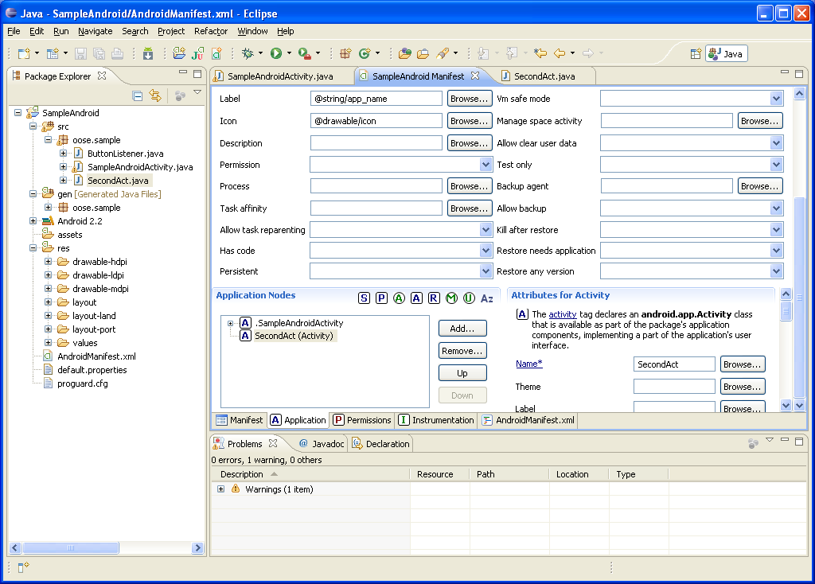
Manifest File – Adding an Activity

Slide 20
Three Main Approaches to build GUI
Java-based
Use Java to define Strings, lay out window, create GUI controls, and assign event handlers. Like Swing programming.
XML- based
Use XML files to define Strings, lay out window, create GUI controls, and assign event handlers. The Java method will read the layout from XML file and pass it to setContentView.
Hybrid
Use an XML file to define Strings, lay out window and create GUI controls. Use Java to assign event handlers.

Slide 21
Java-Based Approach: Template
public class SomeName extends Activity {
  @Override
  public void onCreate(Bundle savedInstanceState) {
    super.onCreate(savedInstanceState);
    String message = "...";
    LinearLayout window = new LinearLayout(this);
    window.setVariousAttributes(…);
    Button b = new Button(this);
    b.setText("Button Label");
    b.setOnClickListener(new SomeHandler());
    mainWindow.addView(b);
    ...
    setContentView( window );
  }
  private class SomeHandler implements OnClickListener {
    @Override
    public void onClick(View clickedButton ){
    doSomething(...);
    }
  } }

Slide 22
XML-Based Approach: Template
Java
public class SomeClass extends Activity {
  @Override
  public void onCreate(Bundle savedInstanceState) {
    super.onCreate(savedInstanceState);
    setContentView(R.layout.main);
  }
  public void handlerMethod (View clickedButton) {
    String someName = getString (R.string.some_name);
    doSomethingWith(someName);
  } }

Slide 23
XML-Based Approach: Template
XML
res/values/strings.xml
<?xml version="1.0" encoding="utf-8"?>
<resources>
<string name="some_name">…</string>
…
</resources>
res/layout/main.xml
<?xml version="1.0" encoding="utf-8"?>
<LinearLayout …>
<TextView … />
<Button … android:onClick="handlerMethod" />
</LinearLayout>

Slide 24
Hybrid Approach: Template
Java
public class SomeClass extends Activity {
  @Override
  public void onCreate(Bundle savedInstanceState) {
    super.onCreate(savedInstanceState);
    setContentView(R.layout.main);
    Button b = (Button)findViewById(R.id.button_id);
    b.setOnClickListener(new SomeHandler());
  }
  private class SomeHandler implements OnClickListener {
    @Override
    public void onClick(Vie w clickedButton) {
    doSomething (...);
    }
  } }
XML
Controls that need handlers are given IDs
You do not use android:onClick to assign handler

Slide 25
Basic widgets
TextView
  TextView allocates an area of the screen to display text
  <TextView android:id="@+id/counter“
  android:layout_width="fill_parent"
  android:layout_height="wrap_content"
  android:gravity="center"
  android:padding="10dp"
  android:text="@string/sample_time"
  android:textSize="50sp" >
  </TextView>

Slide 26
Basic widgets
EditText
  An EditText is a TextView that is configured to allow the user to edit the text inside it
  inputType to change the behavior of the EditText:
  <EditText android:layout_width="match_parent" android:layout_height="wrap_content"
  android:inputType="phone" />

Slide 27
Buttons
Represents a push-button widget.
Push-buttons can be pressed, or clicked, by the user to perform an action.
  <Button android:id="@+id/finished"
  android:layout_width="match_parent“
  android:layout_height="wrap_content“
  android:text="@string/finished" >
  </Button>

Slide 28
Boolean Buttons
Buttons are convenient for indicating on/off states.
Android has a number of views, including toggle buttons, checkboxes, and radio buttons.

Slide 29
Basic widgets
ImageView
  The ImageView class can load images from various sources (such as resources or content providers)

Slide 30
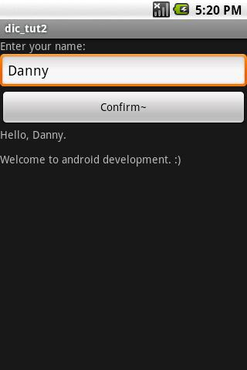
Homework
Create a application as following Picture by using XML based appoach and java based appoach

Slide 31
Thank you!

